Slide 1

Geo-location clustering using K-means algorithm:

Slide 2
What is K means?
K-means is an unsupervised clustering algorithm.
Clustering is a method of isolating the population or data points, gathering them into various clusters based on likeness and uniqueness between them.
It's helps in deciding the characteristic gathering among the unlabeled pieces of information.
Applications:-
Customer segmentation
Image grouping
search results clustering

Slide 3
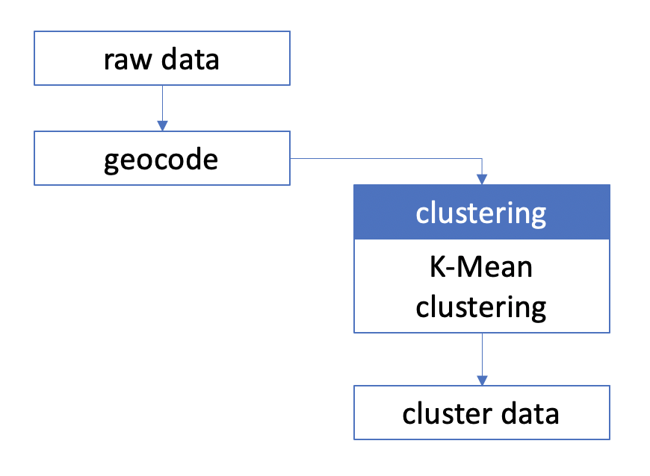

Slide 4
Environment Setup
We used AWS to create an s3 bucket and loaded all the data.
Created EC2 key pair and SPARK cluster.
Accessed the application by adding SSH22 and custom TCP 8888 ports.
Later we installed jupyter by using
We exported the pyspark driver file and set this driver file location of jupyter.
With the help of pyspark command accessed jupyter notebook ob the port 8888

Slide 5
To perform a cluster analysis, generally, the data should be prepared as follows:
Rows are observations (individuals) and columns are variables
Any missing value in the data must be removed or estimated.
The data must be standardized (i.e., scaled) to make variables comparable.
Uploaded and loaded the datasets in to the s3 bucket
We analyzed each datasets and splitted the data in to training and testing data.
Later we performed data cleaning which involved removing unnecessary data.
We have used device status preparation, synthetic clustering preparation and DB pedia location data preparation and also done the visualizations for them.
Data Preparation

Slide 6
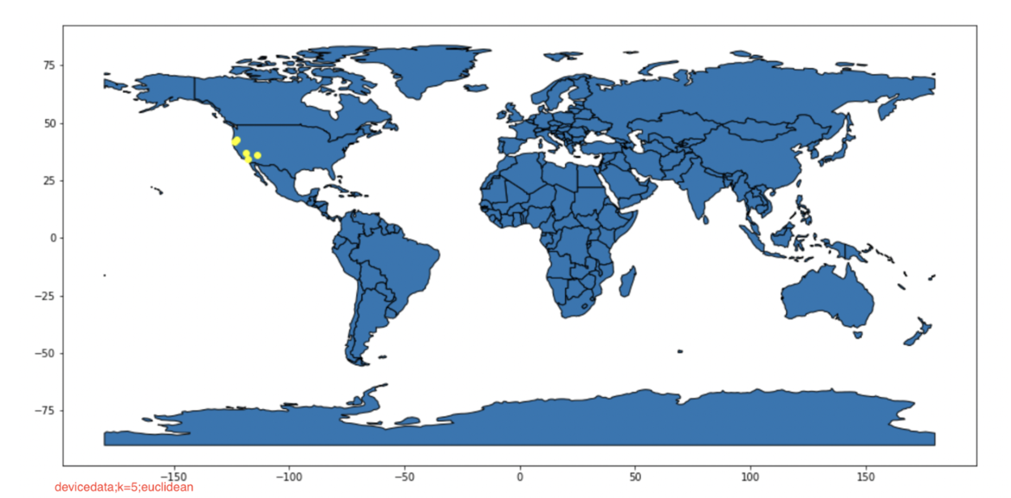
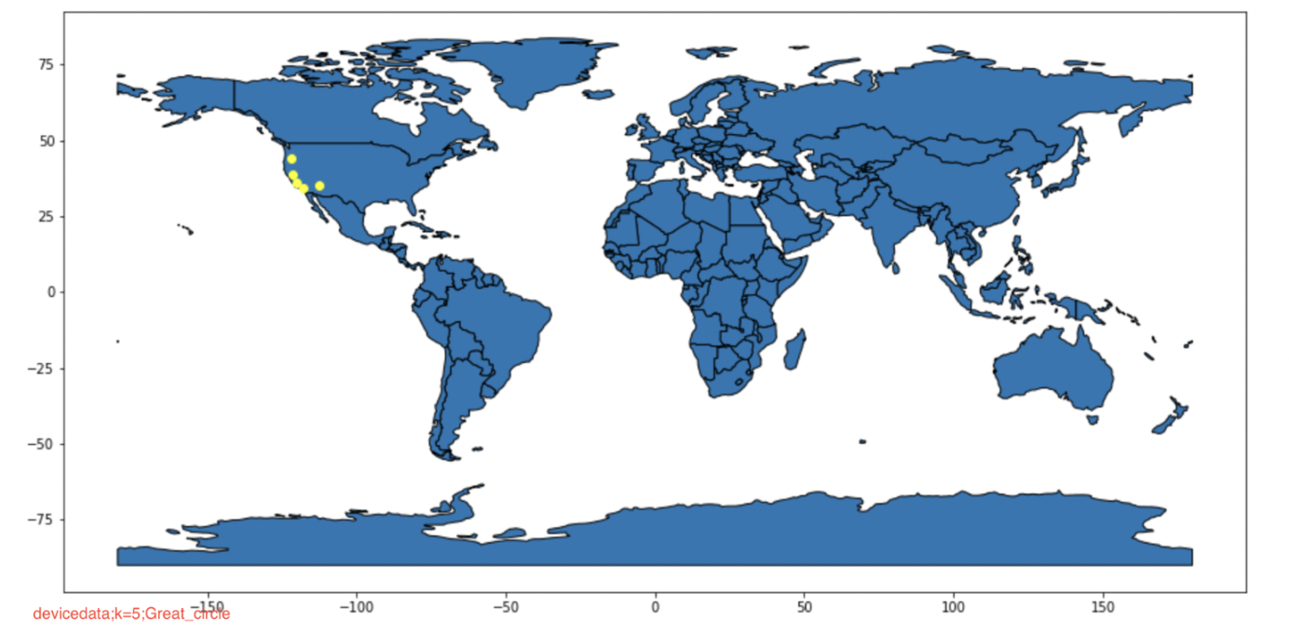
EUCLIDEAN DISTANCE, GREAT-CIRCLE DISTANCE, K-VALUES:
Device data location, Euclidean distance, k=5
Device data location, great-circle distance, k=5

Slide 7
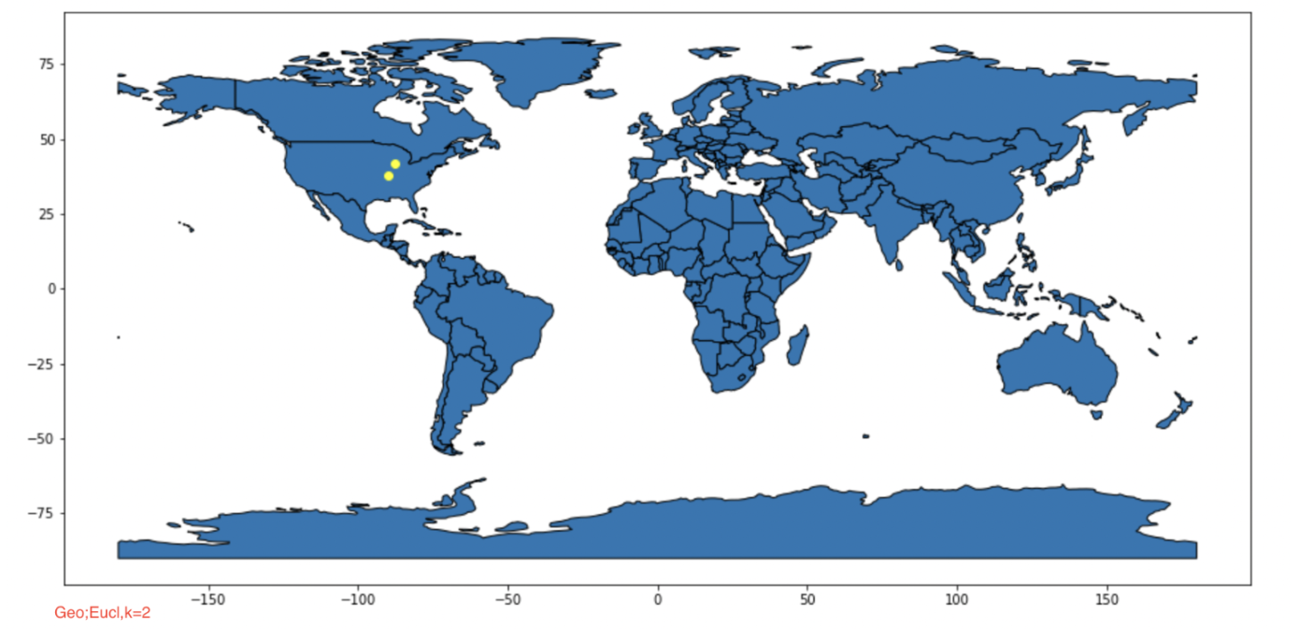
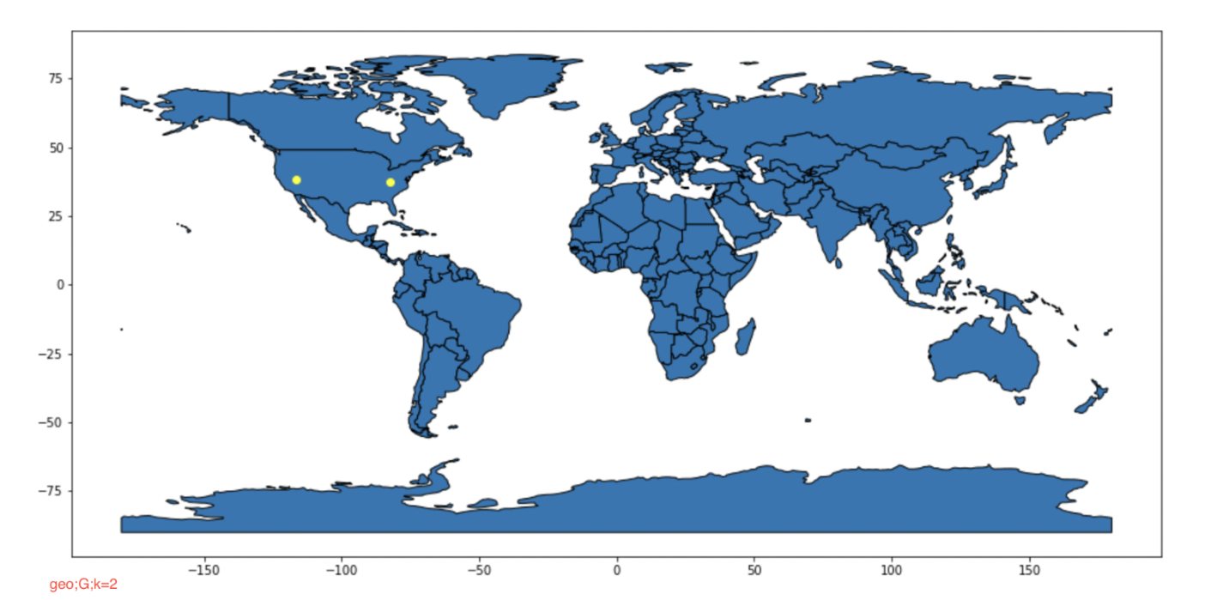
Synthetic location data, Euclidean distance, k=2
Synthetic location data, great-circle distance, k=2

Slide 8
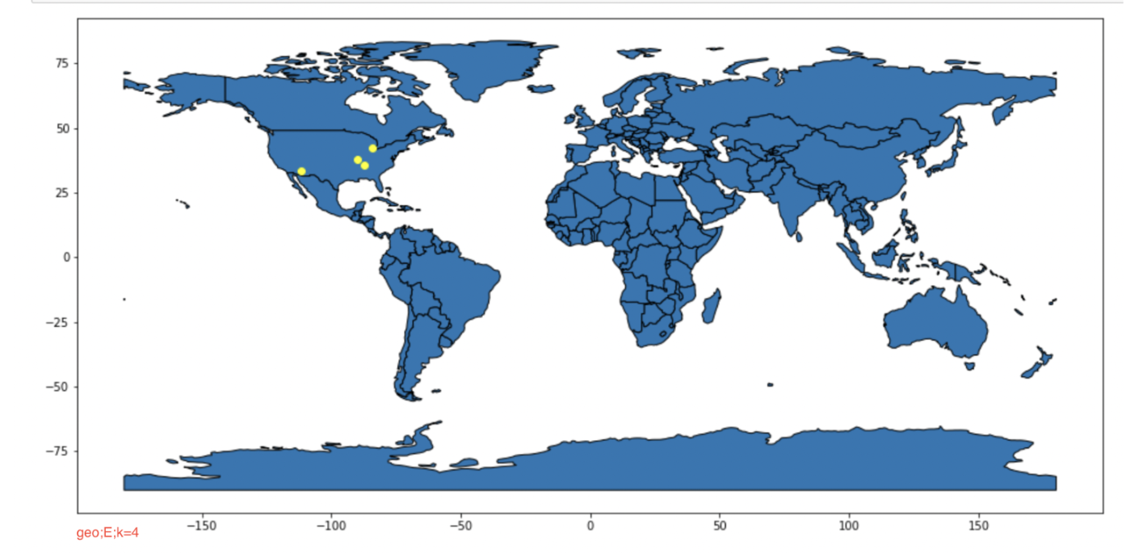
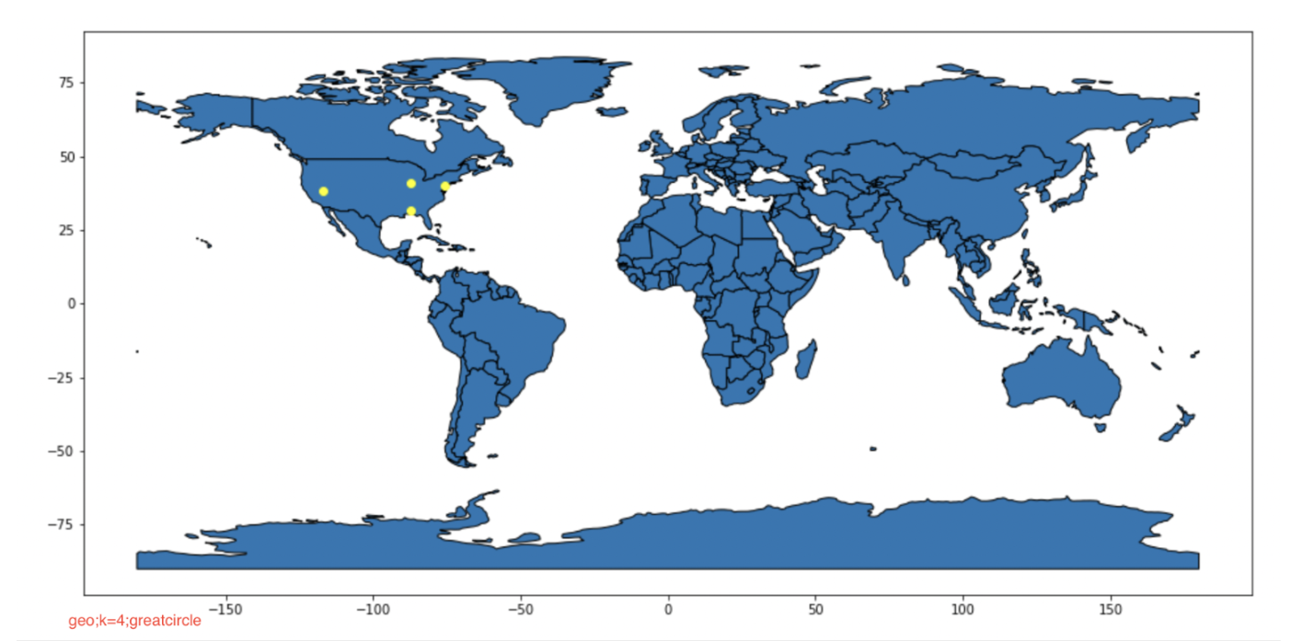
Synthetic location data, Euclidean distance, k=4
Synthetic location data, great-circle distance, k=4

Slide 9
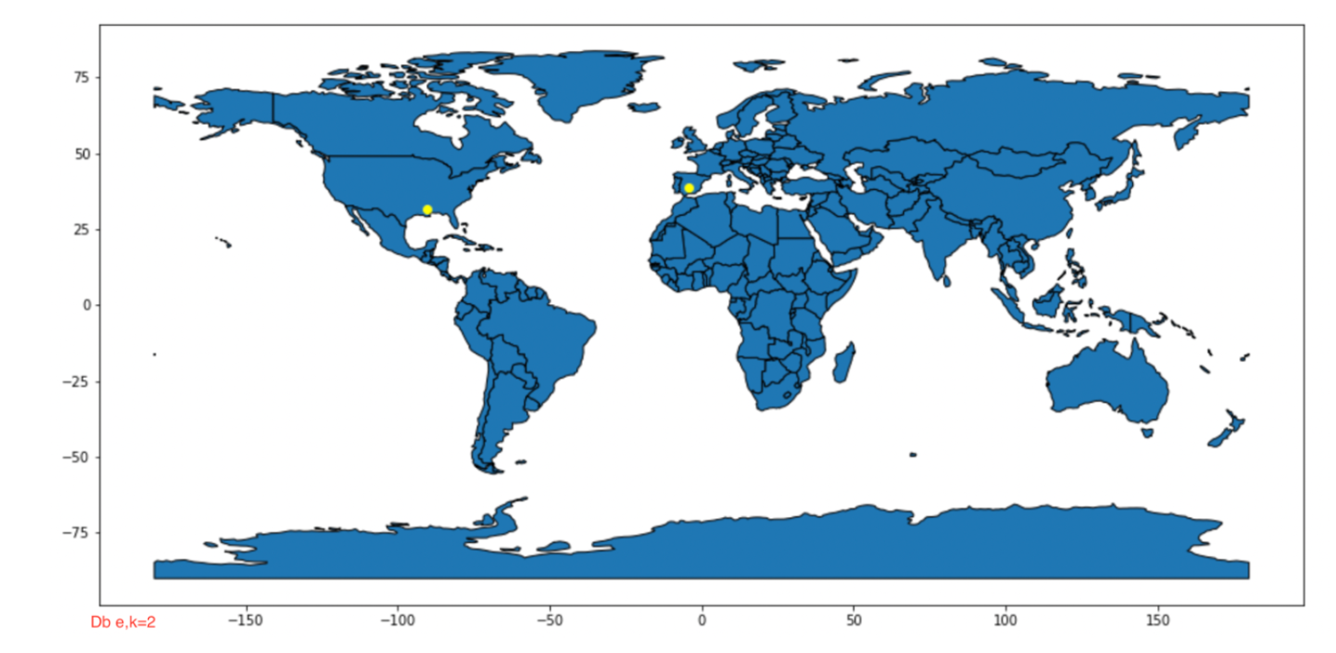

DB pedia location data, Euclidean distance, k=2
DB pedia location data, great-circle distance, k=2

Slide 10
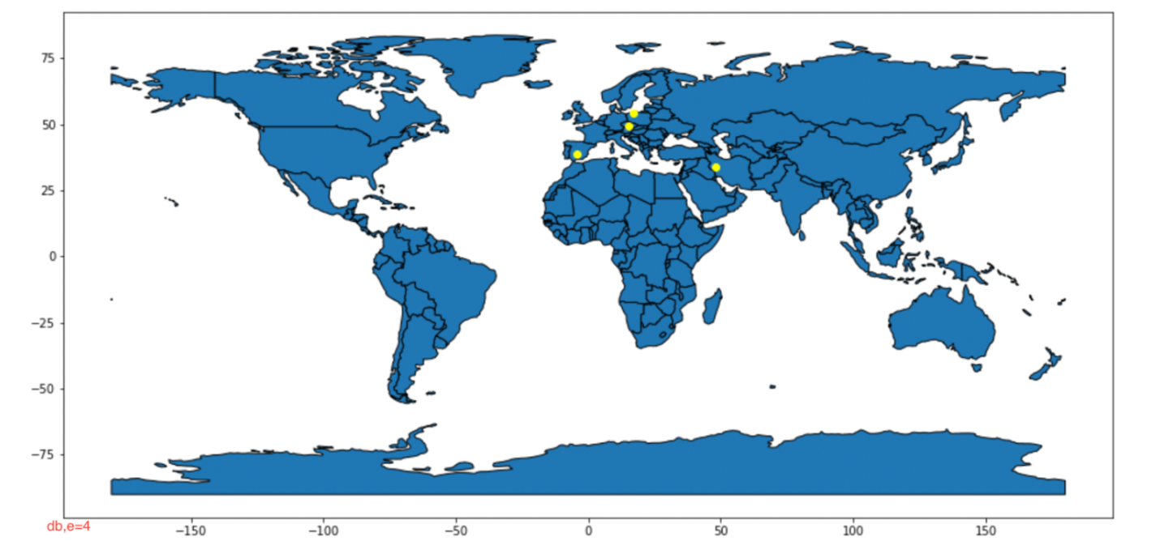
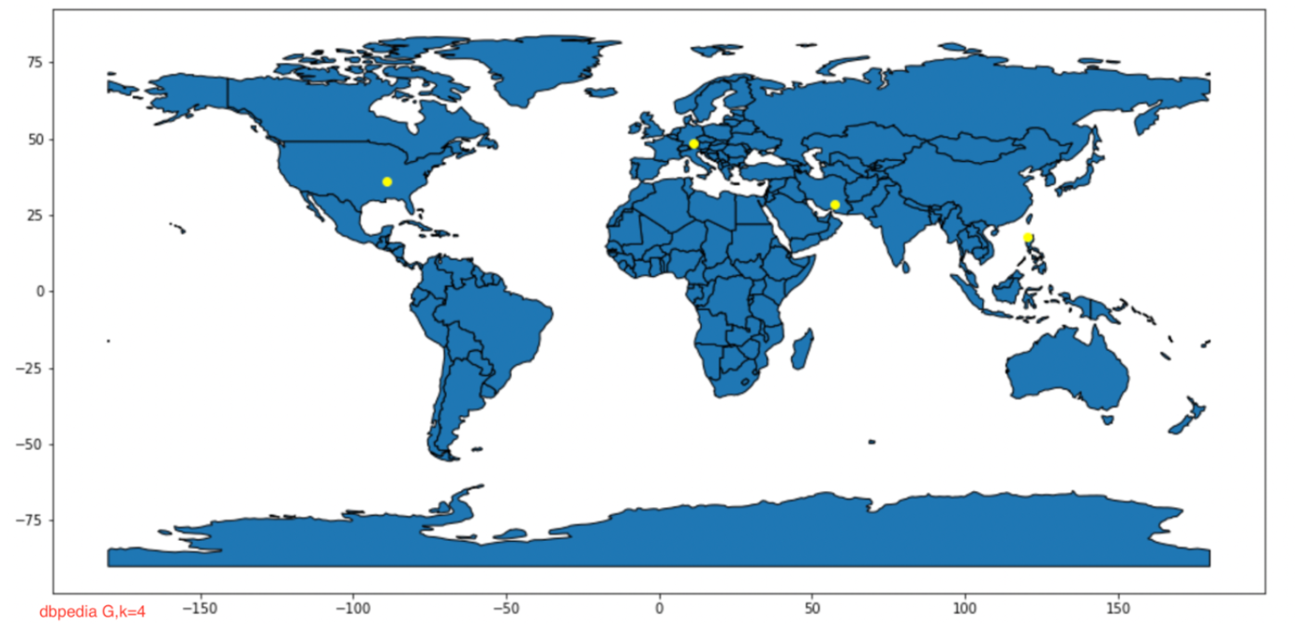
DB pedia location data, Euclidean distance, k=4
DB pedia location data, great-circle distance, k=4

Slide 11

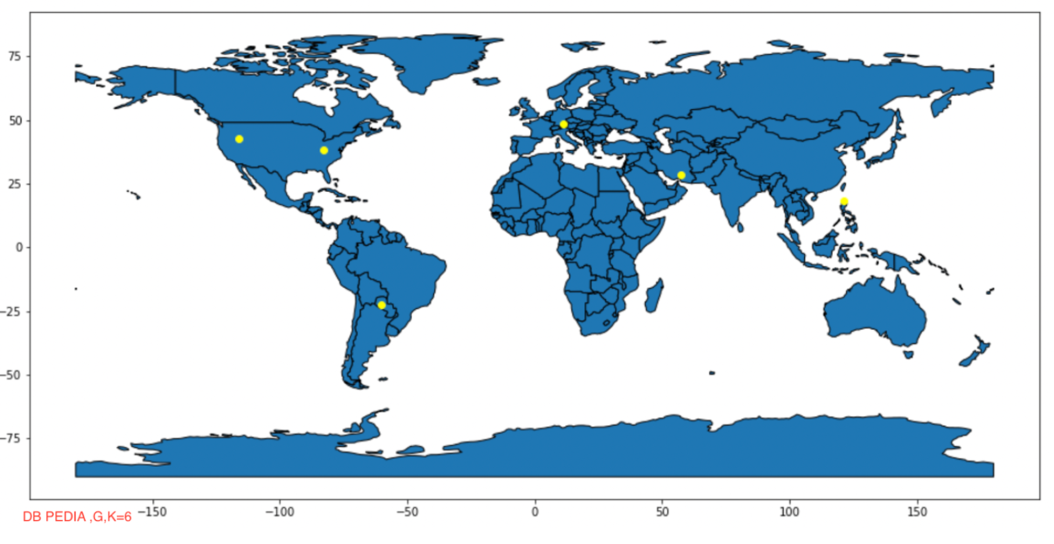
DB pedia location data, Euclidean distance, k=6
DB pedia location data, great-circle distance, k=6

Slide 12
K-means implementation in pyspark:
Now , the data is in lat-long pairs to form the clusters.
We have considered two metric to calculate the distance .
Euclidean
Great Circle
We initialized the function by giving number of clusters and computed the distance from each pair to the clusters and calculated the centroid
We performed an iterative process until the new and old centroids converge and number of iteration come to an end.
Now we got the new centroids which are the clusters of data.

Slide 13
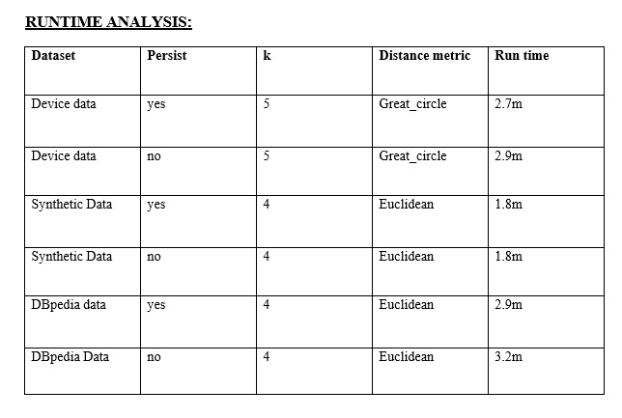
Results:

Slide 14
Conclusion
By analyzing the above results ,there is a relationship between time and persist.
Up on observing , we found that certain k values are not perfect , some are overlapped .
K mean may be reliable for this ,but it may not be robust enough for others.

